Slide 1
CS 211 Computer Architecture Lecture 31: RISC-V Single Cycle Design – Performance, Multicycle design, Pipeline Datapath
Ravi Mittal
ravi.mittal@iitgoa.ac.in
Indian Institute of Technology, Goa

Slide 2
Acknowledgements
Class Presentation, RISC-V CPU Control, Pipelinging, CS61C, Great Ideas in Computer Architecture, University of Berkeley, Morgan Rae Rechenberg
Class Presentation, CS61C, Machine Structures, University of Berkeley, Dan Garcia and Miki Lustig, 2019
Class Presentation, CS61C, Introduction to Assembly Language and RISC-V Instruction Set Architecture, University of Berkeley, Prof Krste Asanović & Randy H. Katz. http://inst.eecs.Berkeley.edu/~cs61c
Computer Organization and Design, The Hardware Software Interface, RISC-V edition, Patterson and Hennessey
Digital Design and Computer Architecture: RISC-V Edition, Harris & Harris Elsevier – Presentation.

Slide 3
RISC-V: So far we have studied
Arithmetic operations: add, sub, addi,
How to bring data from memory to register and vice versa?
lw, sw, lb, sb, lbu
Bit-by-bit logical instructions
and, or, xor, andi, ori, xori
Logical Shift instructions
sll, srl, sra, slli, srli, srai
Generating Constants
Branching Instructions: beq, bne, blt/bltu, bge/bgeu
Jumping instruction: j
Assembly level program for: if, if/else,
Function Calls
Basics, Input arguments and Return Value
while, for loops
The Stack
Basics, How functions use a stack
Stack use in non-leaf function calls
Recursive Functions
Floating Point Numbers
Instruction Formats
Machine Instructions
Microarchitecture
Combinational and Sequential logic
Clock, Registers, Muxes, Adder, Subtractor, Comparator, Buses, Register file, Idealized Memory
Timing considerations, Maximum frequency
Single Cycle Vs Multicycle vs Pipeline
Datapath design for R-type, and I-type Instructions: add, sub, addi, lw, sw, branch instructions
Control Logic design for Single Cycle Datapath

Slide 4
In this lecture, we will study
Performance of Single Cycle Datapath
Multicycle Datapath
Pipeline Concept

Slide 5
Performance of Single Cycle Datapath

Slide 6
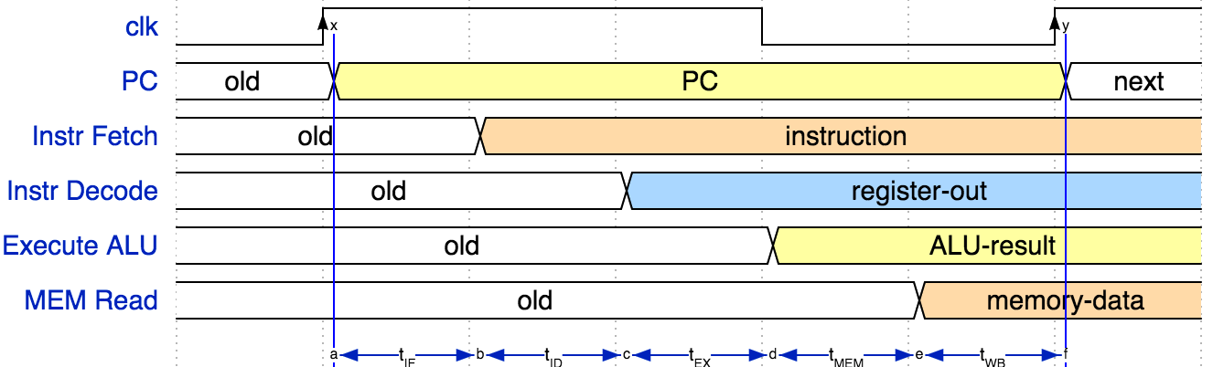
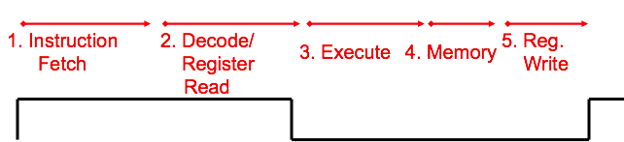
Instruction Timing
IF | ID | EX | MEM | WB | Total
IMEM | Reg Read | ALU | DMEM | Reg W
200 ps | 100 ps | 200 ps | 200 ps | 100 ps | 800 ps
CS61C Prof Dan Garcia and Miki Lustig, Univ of California, Berkeley

Slide 7
Instruction Timing
Instr | IF = 200ps | ID = 100ps | ALU = 200ps | MEM=200ps | WB = 100ps | Total
add | X | X | X |  | X | 600ps
beq | X | X | X |  |  | 500ps
jal | X | X | X |  | X | 600ps
lw | X | X | X | X | X | 800ps
sw | X | X | X | X |  | 700ps
Maximum clock frequency
fmax = 1/800ps = 1.25 GHz
Most blocks idle most of the time! ex. “IF” active after every 600ps
Instruction 1
Instruction 2
IF
ID
ALU
MEM
WB
IF
ID
ALU
MEM
WB
Clk
CS61C Prof Dan Garcia and Miki Lustig, Univ of California, Berkeley

Slide 8
Performance Measures
In our example, CPU executes instructions at 1.25 GHz
1 instruction every 800 ps
Can we improve its performance?
What do we mean with this statement?
At what level?
At task level:
Quicker response time, so one job finishes faster?
More jobs per unit time (e.g. web server returning pages)?
Longer battery life?
At datapath level for Single Cycle ?
CS61C Prof Dan Garcia and Miki Lustig, Univ of California, Berkeley

Slide 9
“Iron Law” of Processor Performance
Time = Instructions Cycles Time
Program Program * Instruction * Cycle
CS61C Prof Dan Garcia and Miki Lustig, Univ of California, Berkeley

Slide 10
Instructions per Program
Determined by
Task
Algorithm, e.g. O(N²) vs O(N)
Programming language
Compiler
Instruction Set Architecture (ISA)
Time = Instructions Cycles Time
Program Program * Instruction * Cycle
CS61C Prof Dan Garcia and Miki Lustig, Univ of California, Berkeley

Slide 11
(Average) Clock cycles per Instruction, or CPI
Determined by
ISA and processor implementation (or microarchitecture)
E.g. for “our” single-cycle RISC-V design, CPI = 1
Complex instructions (e.g. strcpy), CPI >> 1
True for most CISC languages
Superscalar processors, CPI < 1 (Will study later)
Time = Instructions Cycles Time
Program Program * Instruction * Cycle

Slide 12
Time per Cycle (1/Frequency)
Determined by
Processor microarchitecture (processor critical path)
Technology (e.g. transistor size)
Power budget (lower voltages reduce transistor speed)
Time = Instructions Cycles Time
Program Program * Instruction * Cycle

Slide 13
Speed Trade-off Example
For some task (e.g. image compression) …
 | Processor A | Processor B
# Instructions | 1 Million | 1.5 Million
Average CPI | 2.5 | 1
Clock rate f | 2.5 GHz | 2 GHz
Execution time | 1 ms | 0.75 ms
Processor B is faster for this task, despite executing more instructions and having a lower clock rate! Why? Each instruction is less complex! (~2.5 B instructions = 1 A instruction)

Slide 14
Trivia
If we reduce the time a program takes to execute by pipelining our CPU, which factor is likely to shrink?
Instructions per program
Cycles per instruction
Time per cycle
Time = Instructions Cycles Time
Program Program * Instruction * Cycle

Slide 15
Trivia
If we reduce the time a program takes to execute by pipelining our CPU, which factor is likely to shrink?
Instructions per program
Cycles per instruction (This will increase!)
Time per cycle
Time = Instructions Cycles Time
Program Program * Instruction * Cycle
CS61C Prof Dan Garcia and Miki Lustig, Univ of California, Berkeley

Slide 16
Multicycle Datapath

Slide 17
Ways of Datapath and Control Design
There are many ways of designing the data path and control logic
Single-cycle, multi-cycle, pipelined datapath
Hardwired/combinational vs. microcoded/microprogrammed control
Control signals generated by combinational logic versus
Control signals stored in a memory structure
Control signals and structure depend on the datapath design

Slide 18
Single-cycle vs. Multi-cycle: Control and Data
Single-cycle machine:
Everything related to an instruction happens in one clock cycle
Simple
Cycle time limited by longest instruction (lw)
Multi-cycle machine:
Higher clock speed
Simpler instructions run faster
Control signals needed in the next cycle can be generated in the current cycle
Motivation: avoid making all instructions take as long as the slowest one
Single-cycle
Multicycle

Slide 19
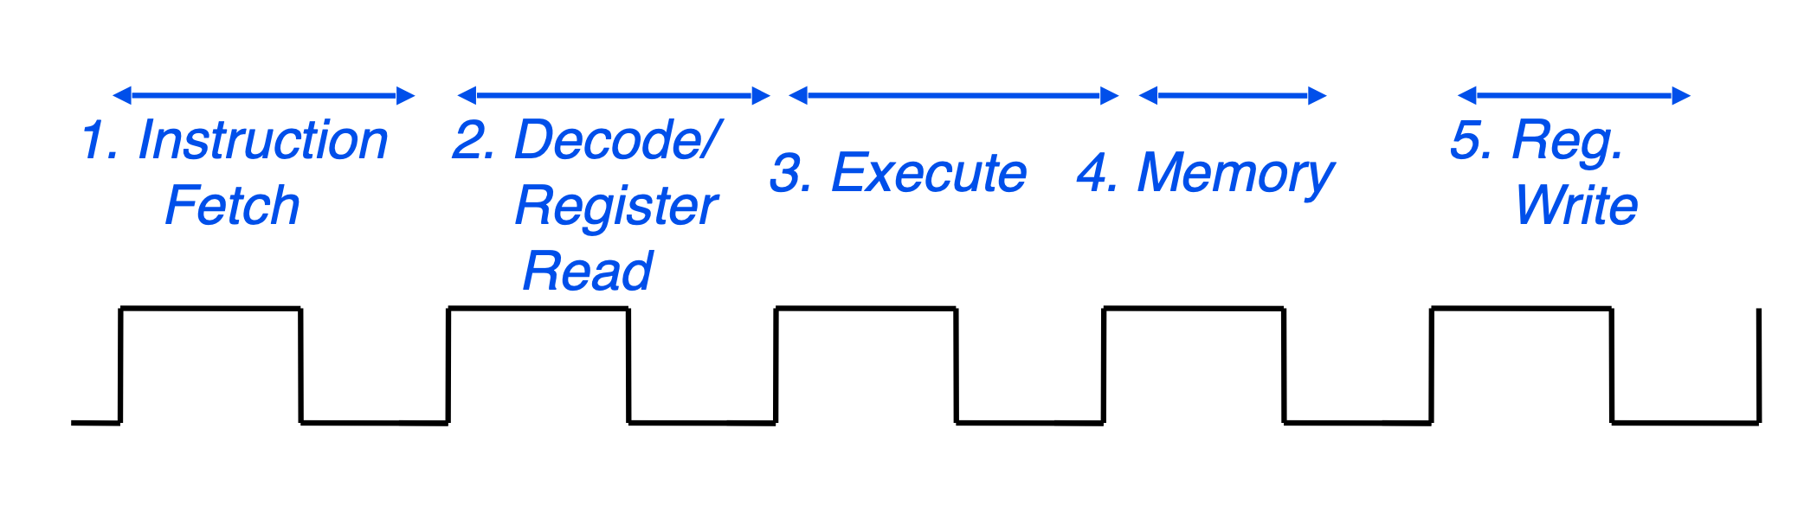
Multicycle Processor
Only one stage of instruction per clock cycle
The clock is made as long as the slowest stage
Advantage over single cycle execution:
Unused stages in a particular instruction can be skipped
CS61C Prof Dan Garcia and Miki Lustig, Univ of California, Berkeley

Slide 20
Multicycle Approach
Breakup the instructions into steps,
Each step takes a cycle
Balance the amount of work to be done
Restrict each cycle to use only one major functional unit
At the end of a cycle
Store values for use in later cycles (easiest thing to do)
Introduce additional (internal) registers

Slide 21
Multicycle RISC-V Processor
Ref: Digital Design and Computer Architecture: RISC-V Edition, Harris & Harris Elsevier

Slide 22
Multicycle Datapath Approach
Replace Instruction and Data memories with a single unified memory – more realistic
In the single-cycle design, we used separate instruction and data memories because we needed to read the instruction memory and read or write the data memory all in one cycle
Use of new non-architectural state elements
Instruction Register
Registers to store output from Register File, ALU output
Now we can reuse functional units
ALU used to compute address and to increment PC
Memory used for instruction and data

Slide 23
Multicycle RISC-V Processor – Note use of Registers
Ref: Digital Design and Computer Architecture: RISC-V Edition, Harris & Harris Elsevier

Slide 24
Reasons for not using Multicycle Design
Benchmark - SPECINT2000 – contains approximately
25% loads, 10% stores, 11% branches, 2% jumps, and 52% R-type instructions
Average CPI = 4.14 → Not much benefit
Cycle time is not exactly equal to one fifth of single cycle design
Due to fact that not all steps are of the same length
Additional complexity compared to single cycle design
Not in use

Slide 25
Pipeline Concept

Slide 26
Pipeline Analogy: Doing Laundry
Mira, Nidhi, Bobby, and Ayush each have one load of clothes to wash, dry, fold, and Iron(Press)
Washer takes 30 minutes
Dryer takes 30 minutes
“Folder” takes 30 minutes
“Ironing” takes 30 minutes to iron clothes
M
N
B
A
Ref: CS61C Morgan Reschenberg, Univ of California, Berkeley
Notes:
lol wash the MIPS green shirts

Slide 27
Sequential Laundry (in Covid times)
6 PM
7
8
9
10
11
12
1
2 AM
30
30
30
30
30
30
30
30
30
30
30
30
30
30
30
30
T
a
s
k
O
r
d
e
r
Sequential laundry takes 8 hours for 4 loads
1 load finishes every 2 hours, and Ayush is up til 2 AM...
Time
M
B
N
A
Ref: CS61C Morgan Reschenberg, Univ of California, Berkeley

Slide 28
Pipelined Laundry
6 PM
7
8
9
10
11
12
1
2 AM
T
a
s
k
O
r
d
e
r
30
30
30
30
30
Time
30
30
M
B
N
A
Pipelined laundry takes 3.5 hours for 4 loads!
1 load finishes every half hour (after the first load, which takes 2 hours)

Slide 29
Pipelining Lessons (1/2)
Pipelining doesn’t decrease latency of single task; it increases throughput of entire workload
Multiple tasks operating simultaneously using different resources
Potential speedup ~ number of pipeline stages
Speedup reduced by time to fill and drain the pipeline: 8 hours/3.5 hours which gives 2.3X speedup vs. potential 4X in this example
6 PM
7
8
9
T
a
s
k
O
r
d
e
r
Time
30
30
30
30
30
30
30
M
B
N
A
Ref: CS61C Morgan Reschenberg, Univ of California, Berkeley

Slide 30
Pipelining Lessons (2/2)
6 PM
Suppose new Washer takes 20 minutes, new Iron takes 20 minutes. How much faster is pipeline?
Pipeline rate limited by slowest pipeline stage
Unbalanced lengths of pipeline stages reduces speedup
7
8
9
T
a
s
k
O
r
d
e
r
Time
20
30
30
20
20
30
30
M
B
N
A
Ref: CS61C Morgan Reschenberg, Univ of California, Berkeley

Slide 31
Pipelined Datapath

Slide 32
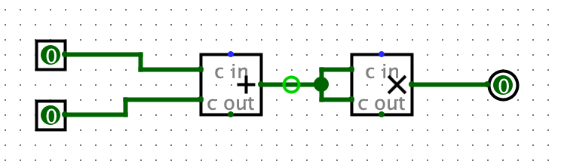
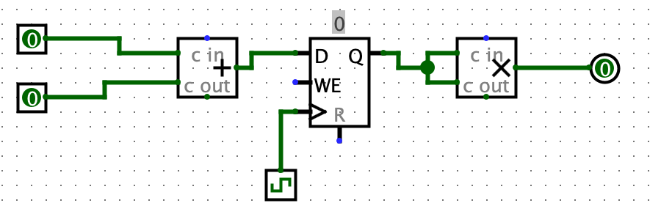
Quick review: Circuit pipelining!
When we calculate cycle time, or critical path, we do so between state elements, inputs, and outputs.
Adding registers between circuit components decreases our critical path and increases our frequency
Ref: CS61C Morgan Reschenberg, Univ of California, Berkeley

Slide 33







Pipelining with RISC-V
Phase | Pictogram | t_{step} Serial
Instruction Fetch |  | 200 ps
Reg Read |  | 100 ps
ALU |  | 200 ps
Memory |  | 200 ps
Register Write |  | 100 ps
t_{instruction} |  | 800 ps
t_{cycle} Pipelined
200 ps
200 ps
200 ps
200 ps
200 ps
1000 ps
t_{instruction}
add t0, t1, t2
or t3, t4, t5
instruction sequence
sll t6, t0, t3
t_{cycle}
Ref: CS61C Morgan Reschenberg, Univ of California, Berkeley
Notes:
Tc = “Time between completion of instructions”

Slide 34
Pipeline Performance
Tc - time between completion of instructions
to measure speedup
Speedup is due to increased throughput
Latency for each instruction does not decrease, in fact it may increase if our stages are uneven!
It takes longer for the first instruction to finish, but every instruction after finishes faster!
Ref: CS61C Morgan Reschenberg, Univ of California, Berkeley

Slide 35
Pipeline Performance
Assume time for stages is
100ps for register read or write
200ps for other stages
Compare pipelined datapath with single-cycle datapath
Instr | Instr fetch | Register read | ALU op | Memory access | Register write | Total time
ld (lw) | 200ps | 100 ps | 200ps | 200ps | 100 ps | 800ps
sd (sw) | 200ps | 100 ps | 200ps | 200ps |  | 700ps
R-format | 200ps | 100 ps | 200ps |  | 100 ps | 600ps
beq | 200ps | 100 ps | 200ps |  |  | 500ps
Ref: CS61C Morgan Reschenberg, Univ of California, Berkeley

Slide 36
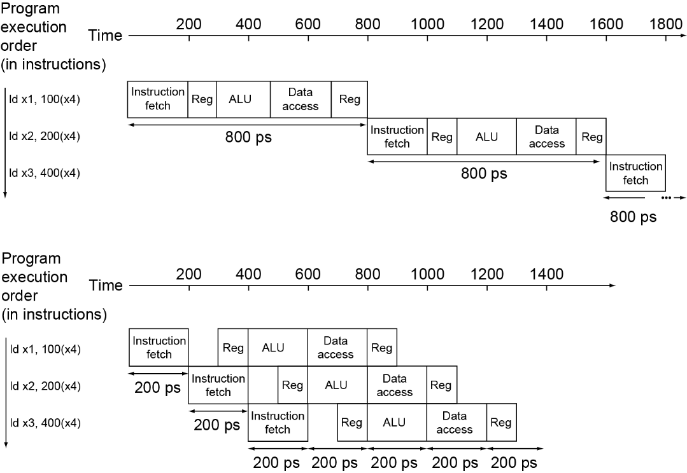
Pipeline Performance
Single-cycle (T_{c}= 800ps)
Pipelined (T_{c}= 200ps)
Ref: CS61C Morgan Reschenberg, Univ of California, Berkeley

Slide 37
Pipeline Speedup
If all stages are balanced
i.e., all take the same time
Time between instructions_{pipelined} = Time between instructions_{nonpipelined} Number of stages
Spedup = Number of stages in the pipeline
If not balanced, speedup is less
Speedup due to increased throughput
Latency (time for each instruction) does not decrease
Ref: CS61C Morgan Reschenberg, Univ of California, Berkeley

Slide 38
Lecture Summary
Multicycle Datapath – Not in use
Single cycle Datapath – Too inefficient - Not in use
Pipelining improves performance by exploiting Instruction Level Parallelism
5-stage pipeline for RV32I: IF, ID, EX, MEM, WB
Executes multiple instructions in parallel
Each instruction has the same latency, but there’s better throughput
Think: what problems does pipelining introduce?

